Slide 1
Counting Zebras: Sampling Designs for Newly Infested Lakes
Jake Ferguson (jakeferg@umn.edu)
John Fieberg, Michael McCartney
Naomi Blinick, Leslie Schroeder, Sarah Baker
Notes:
Hi thanks for coming, today I get to talk to you about counting zebra mussels.
We are going to talk about why something that seems very simple, going out to a lake and counting ZM’s can be improved by using some ideas from statistics to design these surveys to make sure that we sample efficiently

Slide 2
Spread of zebra mussels in MN
Data from USGS Nonindigenous Aquatic Species Information Resource
Notes:
First detected in 1989 in Lake Superior. Mechanisms of spread natural can be natural dispersal between connected waterways (rivers).
However, human aided dispersal is also an important factor in their spread. adults can attach to boats, nets, docks, etc. l
larval zm’s can survive in any bits of water that are not properly drained in boats

Slide 3
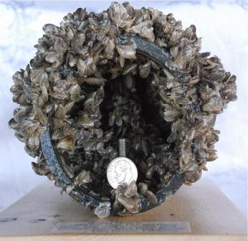
Ecological & economic impacts
Changes in water chemistry
Decreased plankton densities
Changes in water clarity
Increased plant cover
Decreased native mussel populations
Photo: Mussel Prevention Program, San Luis Obispo County
Notes:
Ecological and environmental impacts
It has been documented that zms can alter their environment by increasing ammonium and nitrate
There have been a number of documented changes in water chemistry, water clarity
Decreases in plankton production mean less food for fish
economic impacts
The photo on the right
The zms can occur at extremely high densities growing over each other in like cancerous cells. They can reag such high densities can clog intake pipes for industrial applications. Congressional researchers estimated that an infestation of zebra mussel in the Great Lakes cost the power industry alone $3.1 billion in the 1993-1999 period

Slide 4
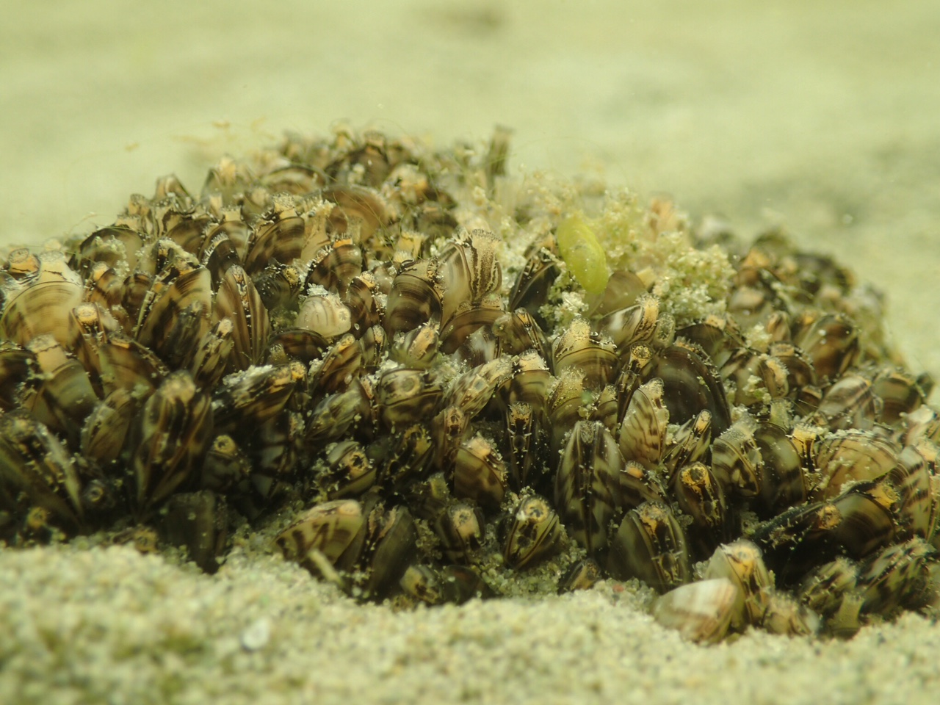
Our goal
Develop methods to reliably survey zebra mussel densities in newly infested lakes
Photo: Naomi Blinick
Notes:
How can a little bit of mathematics help us against this onslaught!?
Our goal is to use apply statistical ideas about effictively sampling a population to develop some guidelines for sampling zms.
This will ensure that we are getting reliable estimates of zebra mussel densities in newly infested MN lakes

Slide 5
Why do we need a sampling protocol?
Allocate and account for survey effort
Determine effects of control over time
Compare control measures across lakes
Provide precise language for managers
Notes:
A sampling design is a proto
1) How do we guide DNR biologists sampling effort? Which lakes should they be spending their time and where in those lakes should they go?
The results of a commonly implemented survey design by lake managers will be
2) In order to determine the effects of candidate control measures, whether it be physical removal or chemical treatments, we need to have accurate measures in the change in
3) finally, in our experience managers use a lot of imprecise language to describe infestation levels such as “relatively well-established”, “plentiful”, “not really there”, so having a quantitative metric could be useful for managers trying to get a handle at the statewide level.

Slide 6
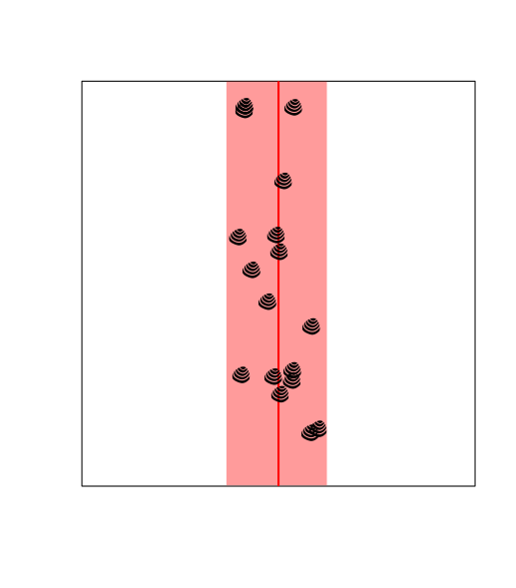
Belt transect sampling
Notes:
There are a number of different ways that biologists count critters in the field. For our purposes we are interested in surveying lakes with low enough densities that simply jumping in the lake and looking that the bottom will not likely yield useful data. Therefore we are designing our study around transects, which allow our scuba-diving field scientists to spend enough time underwater to obtain estimates.
We will have a demonstration at the end of this talk describing this process in more detail, but for now you can think of it as a line where the scientist counts the number of organisms on either side.

Slide 7
Counting Zebras
Video: Naomi Blinick
Notes:
Now this assumption that ZM’s are detectable we have found to be questionable in practice. Lets look at a bit of this video segment of one of our transects.
Note the poor visibility, and the potential difficulties in detecting zm’s which tend to blend into the substrate

Slide 8
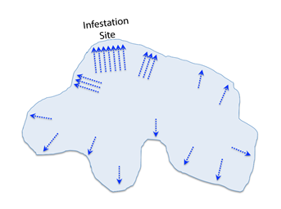
Whole-lake sampling design
Notes:
So far we have only discussed a single transect, however the lakes we are studying are quite large, and a sinlg transect is not sufficient to give us a snapshot of the entire lake. Therefore we are conducting multiple transects on the lake. Our study design focuses much of the effort on the infestation site, this is the location where zms are first reported. We then place moderate effort into two addition sets of 3 transects 150m away from the infestation site. Finally we distribute 10 single transects around the lake.
Get lake list

Slide 9
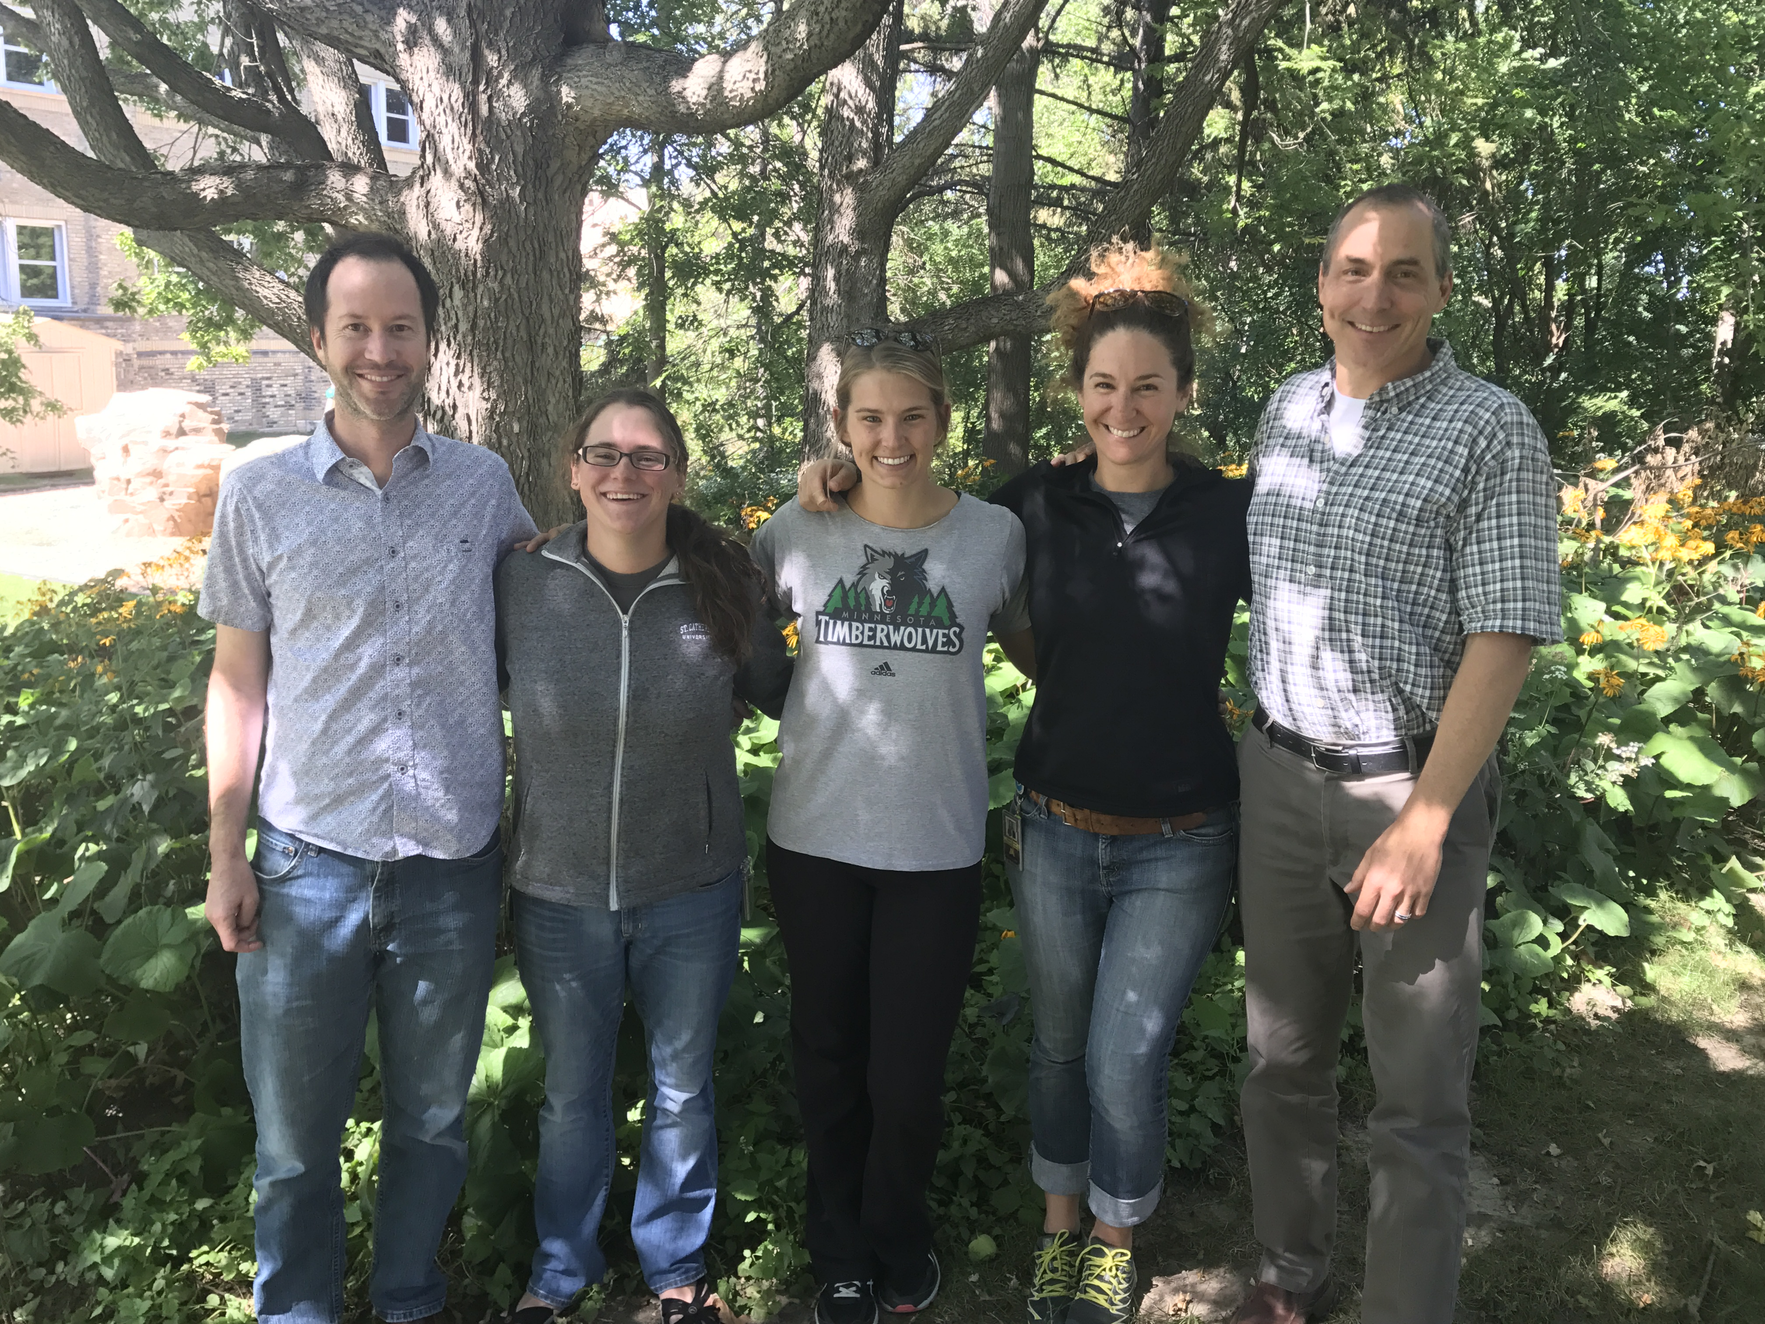
Acknowledgements
Naomi Blinick
Leslie Schroeder
Sarah Baker
John Fieberg
Mike McCartney
Kelsey Vitense
jakeferg@umn.edu

